Slide 1
Protests and Political Violence:
Analysis of the ACLED
Jocelyn Rodal
Associate Research Scholar and Lecturer
Princeton University

Slide 2
ACLED: The Armed Conflict Location & Event Data Project
363MB
Covers: Armed conflict, political violence, and peaceful protests
Includes: locations, dates, political groups involved, violence assessments, and detailed journalistic write-ups for every event
International scope: Africa, Asia, the Middle East, Latin America, Europe, and the USA
US data: 28,337 protest events after January, 2020

Slide 3
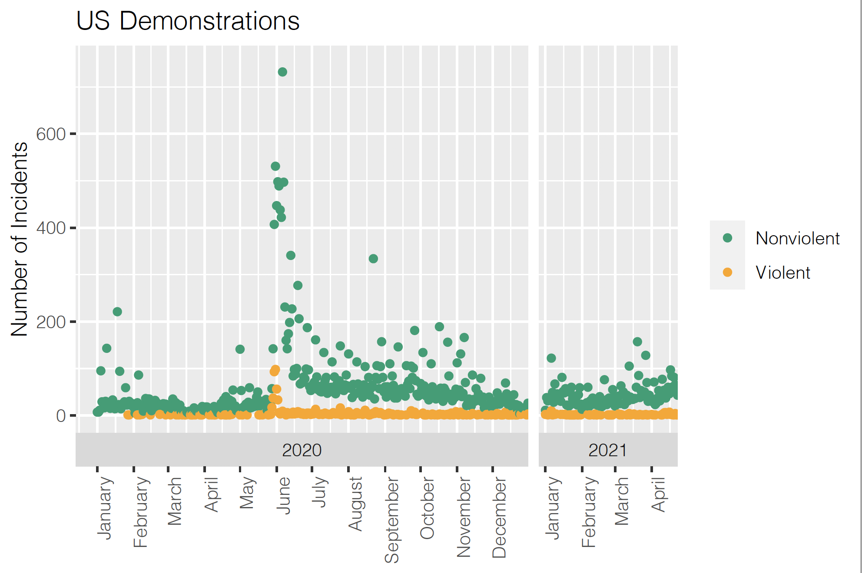

Slide 4
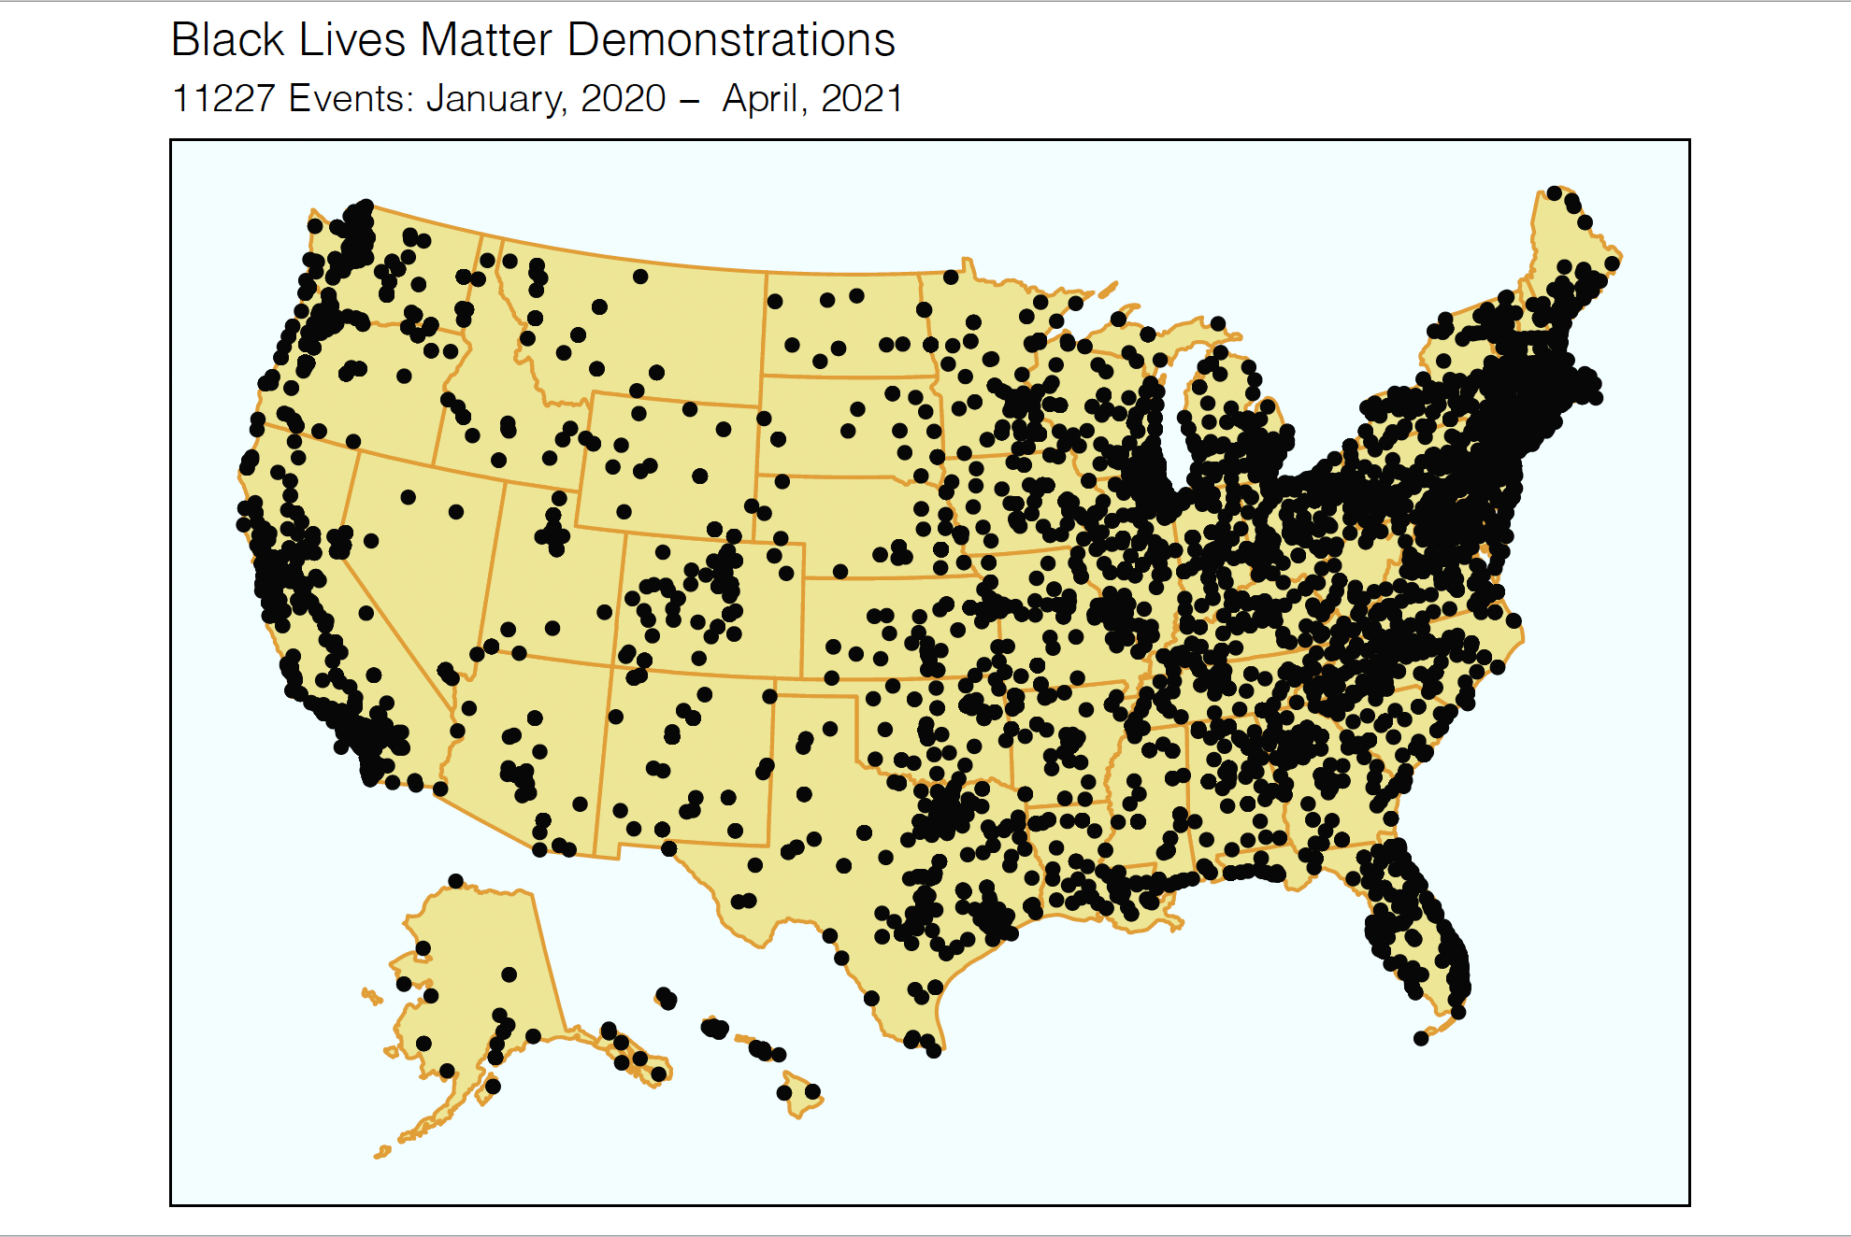

Slide 5
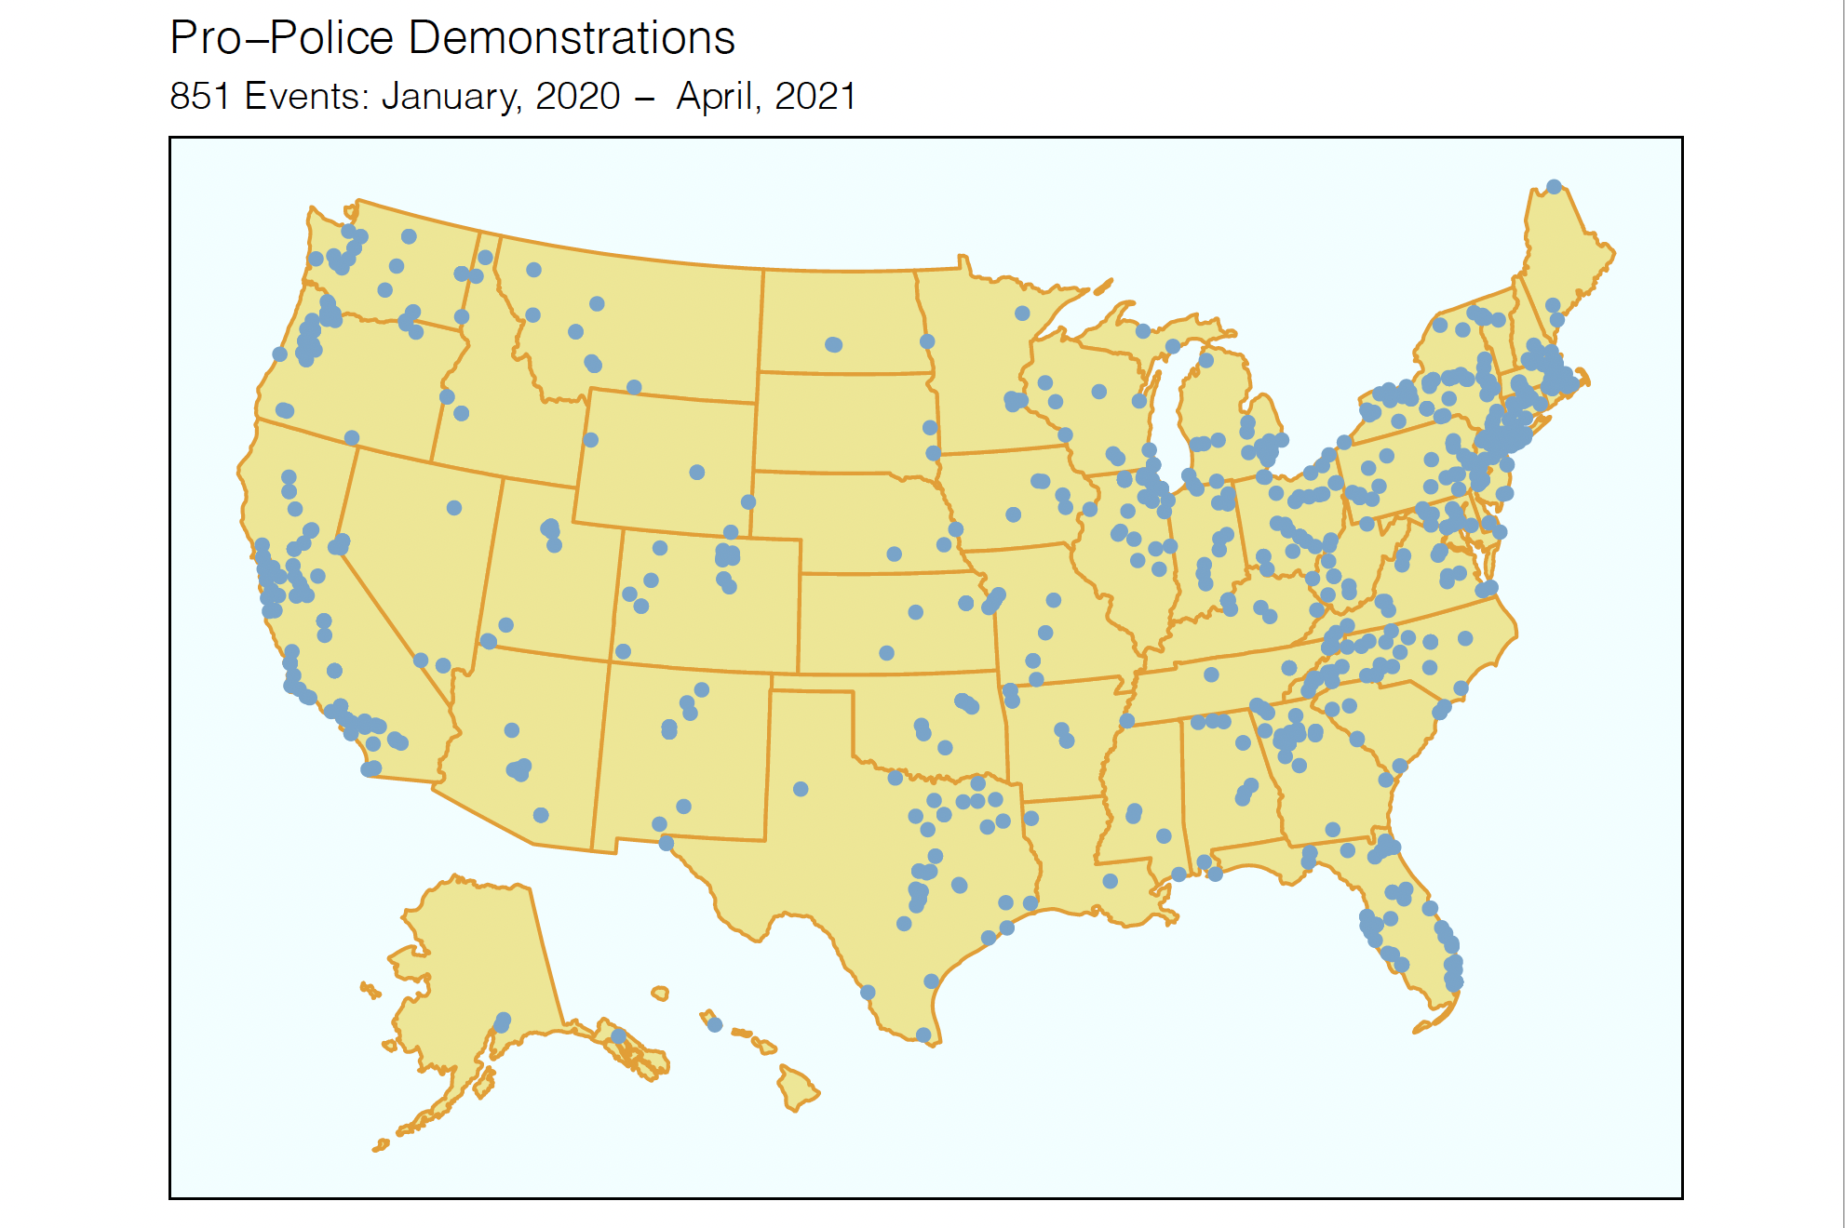

Slide 6
